Slide 1
Advanced Sense & Respond – Predictive and exception based
Automated alerts - Predictive execution - Exception Driven workflows
1
2
Predictive Issue Identification
Real-Time Visibility
Identifies potential
Issues
Dynamic Lead Time Status
PROJECTED ISSUE
Stock Out
In Transit
Forecast, Inventory Requirements
3
3) Proactive Resolution & Execution
Execution Constraint Labor, etc.
Target Service Level
RESOLUTION
Allocation Adjustment
Increased Precision; Generates Value
Current On Hand
Time

Slide 2
Scenario #1: Automatic response to sudden spike in demand
Summary: System senses sudden spike in demand that is more than originally forecasted. System makes appropriate adjustments and propagates demand upstream.
Sequence:
System senses increase in demand from POS for MFG
Automatically responds with the following:
Adjusts the forecast
Creates a new replenishment plan based on new forecast
Aggregates replenishment requirements to generate optimized orders (building appropriate load building)
Automatically sends the predictive alert, order forecast, orders etc to the appropriate vendor
Changes the supply plan
Last minute allocation to (allocate scare inventory based on actual state of inventory in chain)
STORES
CUSTOMER DC
MFG DC
MANUFACTURER
SUPPLIERS

Slide 3
Scenario #2: Automatic response to supply disruption
Scenario: A raw material MFG supplier suddenly becomes unavailable after an unexpected natural disaster. System is bidirectional in its propagation, automatically responds by finding an alternate source of supply based on sourcing algorithm and MFGR’s business rules and propagates impact forward.
Sequence:
System is told supplier is offline
Automatically responds with the following
Uses sourcing algorithm to find alternative source of supply
Cancels all order forecasts, orders, and shipments etc
Creates new order forecasts, orders, shipments, movements etc , for alternate source
Forward propagates impact.
STORES
CUSTOMER DC
MFG DC
MANUFACTURER
SUPPLIERS

Slide 4
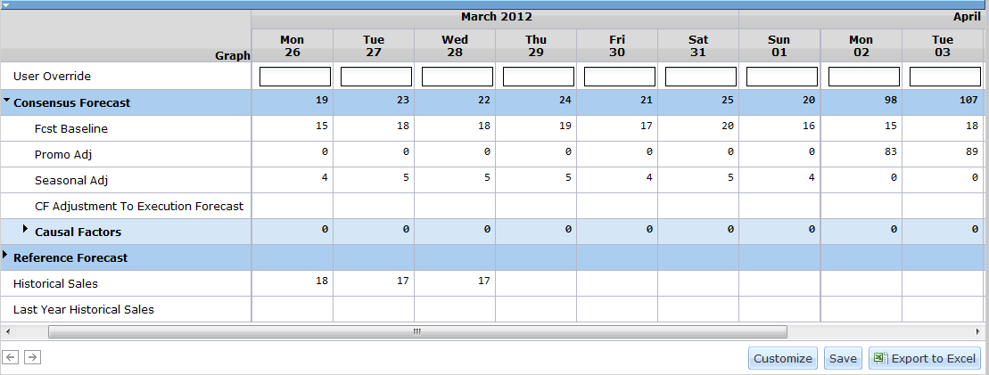
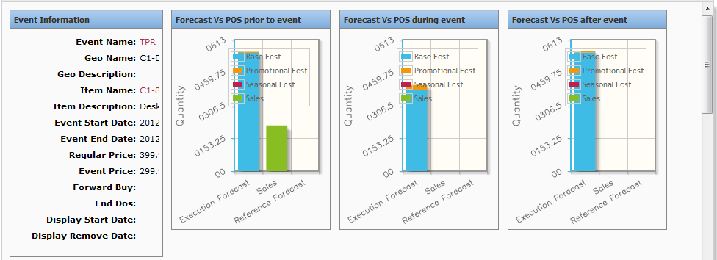
Consumer Driven – Planning/Forecasting Driving IBP/S&OP and Execution
Demand Planning (DP)
Scenario Management
Forecast Patterns
Statistical Forecasts
Forecast Accuracy
Demand Shaping (DP)
Event Management
New Product Introduction
EOL
Demand Sensing (CFM)
Actual Sales vs. Forecast
Recognize pattern and adjust
Advanced Replenishment
Translates sales forecast into multi-echelon order forecast
Demand against each echelon/location

Slide 5
One Network Intelligent Demand
Multi-Echelon
Replenishment
Purchase Order Forecast
CFM
Multi-Echelon
Replenishment
POS Actuals
Shipment Actuals
Store Order Actuals
POS Forecast
Shipment Forecast
Store Order Forecast
DP/BP
Demand Forecast
Order Aggregation
DC1
S1
VNDRDC1
S2
DC2
S3
VMI Order
MRP
ERP
S4
MFG / CPG
Order Communication
Distribution / Retailer
Business Intelligence – Alerts/Exception Workflow – S&OP

Slide 6
Advanced Replenishment
Order Predictions
Translation of demand into time-phased, expected orders at each echelon
Utilizes the furthest forward demand signal available with associated on hand and ordering policies
Ordering policies include (but not limited to):
UOM and packaging
Safety stock – DOS/WOS or fixed quantity
Pallet configurations – ti / hi, full pallet vs. layer multiple
Min / max quantities
Alternate policies – i.e. if over x DOS, then go from full pallet to min of 3 layers
Full truck requirement
Lead times
Delivery schedules
Recognizes demand and constraints at current level +/- 1
Order Management
View and execute externally generated orders
Exception driven workflow alerts – order vs. prediction mismatch, constraint/policy violations, etc.

